Slide 1
General Election 2019
Get out there and Vote!

Slide 2
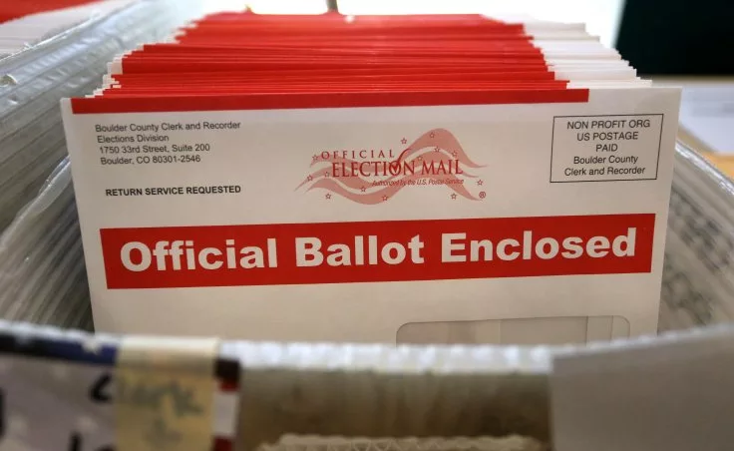
WA State General Election 2019
November 5th 2019
Mail In ballot
You can print your ballet at home

Slide 3

What’s on the ballet
A statewide ballot with State measures, federal candidates, legislative candidates, and judicial candidates
State Senators up for election in District Legislative district 40.

Slide 4
Words to Know
Ballot Measures – aka: Proposition, is a piece of proposed legislation to be approved or rejected by eligible voters. (Direct Democracy)
Referendum - allows citizens, through the petition process, to refer acts of the Legislature to the ballot before they become law.
Initiative - a petition signed by a certain minimum number of registered voters can force a government to choose to either enact a law or hold a public vote
Levy – to impose a tax

Slide 5
But did you Know?
Weather and Harvest dictated Election Timing
Ohio Constitution “No Idiots” Clause
Texas: Vote with a Gun License or Student ID?
America’s Non-elected President

Slide 6
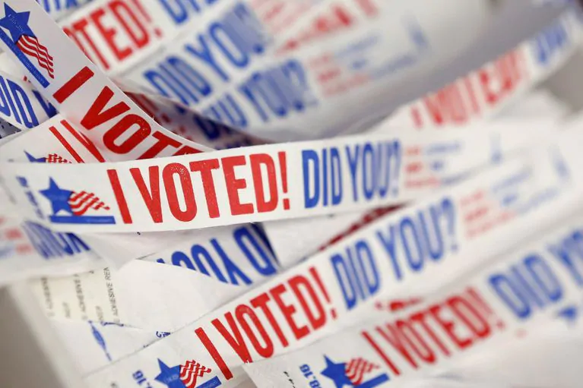
Election Scavenger Hunt
Using a laptop or a computer search the different sites to complete the scavenger hunt.
The Websites to use can be found on Mrulland.weebly.com in the resources tab.
The answers are not on one page, you will have to look.

