Slide 1
The Legislative Branch

Slide 2
Most Important Powers!
Make Laws!!!!
Coin Money
Declare War
Levy taxes (Power of the Purse)
Negotiate Treaties
Regulate interstate commerce

Slide 3
Checks and Balances
Checks on them
Laws can be declared unconstitutional by Judicial Branch
President can veto
Checks on others
Approves Judicial appointments
Override presidential vetoes
Impeach president

Slide 4
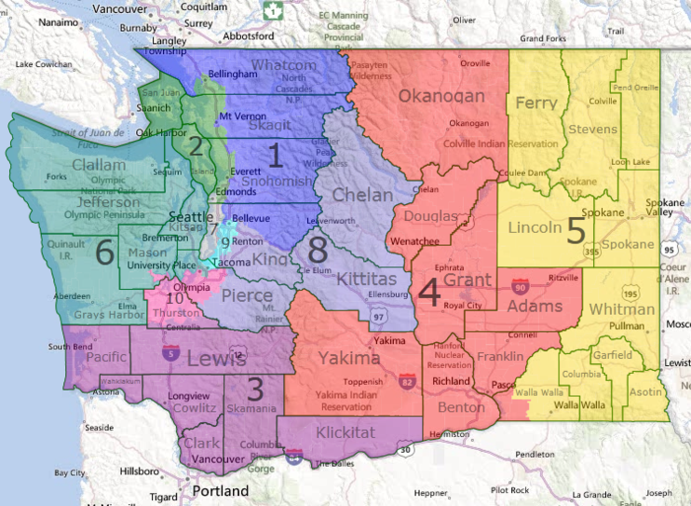
House of Representatives (Congress)
Number of representatives determined by population (pop pop=rep rep)
California = 53; Wyoming, ND, SD, Alaska, Delaware, Vermont, Montana = 1
Washington = 10
Always a total of 435 Members
Each member represents a portion a District within the State.
Sammamish = 8th Congressional district for Washington

Slide 5
Leadership in the House
Speaker of the House: Nancy Pelosi
Nominated by majority, vote in House
Majority Leader: Steny Hoyer
Second in command
Manages legislation on floor
Minority Leader: Kevin McCarthy
Main strategist and leader

Slide 6
Leadership in the House
Majority and Minority whips
A "whip" is an official of a political party whose task is to ensure party discipline in a legislature.
Majority: Jim Clyburn
Minority: Steve Scalise
Responsible for keeping leaders informed and persuading representatives to vote along party lines

Slide 7
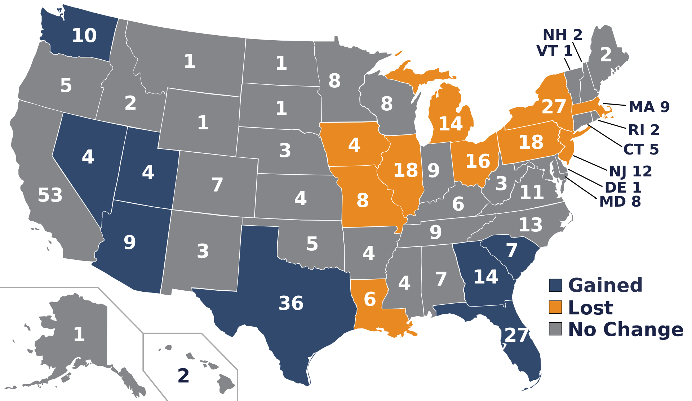

Slide 8
The Senate (Congress)
Every state gets 2 representatives (Great Compromise)
Requirements
30 years old
Citizen for 9 years
Resident of represented state
Term
6-year terms
Incumbents win 90% of the time

Slide 9
Who breaks a tie in the Senate?
The Vice President

Slide 10
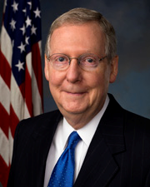
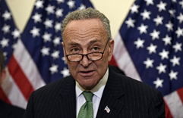
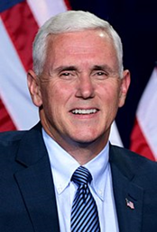
Leadership in the Senate
President of the Senate = Vice President: Mike Pence
President pro tempore: Charles Grassley
Senior member of majority party to preside in president’s absence
Majority and Minority leaders: Mitch McConnell/Chuck Schumer
Work to push legislation
Majority and Minority Whips
Assistants

Slide 12
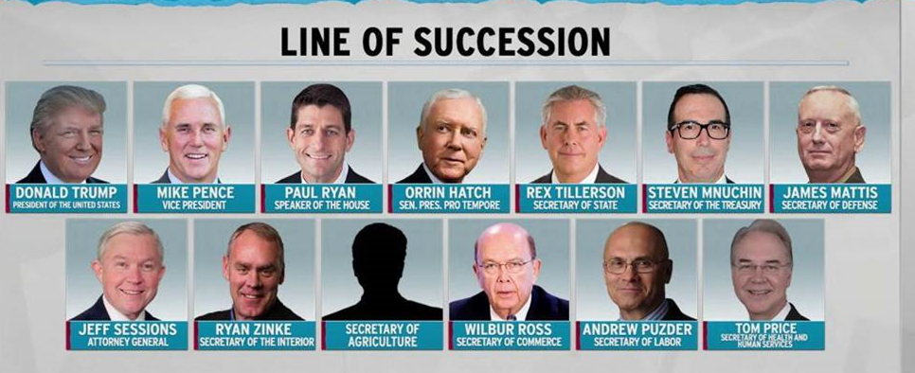
2017

Slide 13
2019

Slide 14
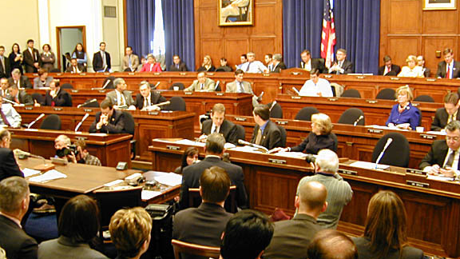
Congressional Committees
Standing Committee
Permanent committees
Handle most of the business
Gather info through hearings and investigations
Broad areas of responsibility

Slide 15
Congressional Committees
Subcommittee
Review proposed legislation
Where bills go to “die”
Special/Select Committee
Temporary
Investigate specific problems
Joint Committees
Deal with issues relevant to both houses
Conference Committee
Irons out differences between house/senate versions of a bill

Slide 17
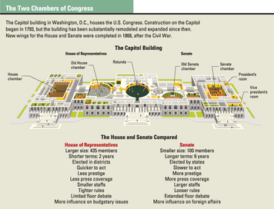

Slide 18
Congress Declaration of War
U.S. soldiers have been sent into action abroad more than 200 times
Formal Declaration- only 5 times
Any guesses when the last time the U.S. Congress declared war?
Joint Resolution
Becomes law once a President signs it
Authorization use of military force

Slide 19
Making a Bill
https://www.youtube.com/watch?v=FFroMQlKiag

Slide 20
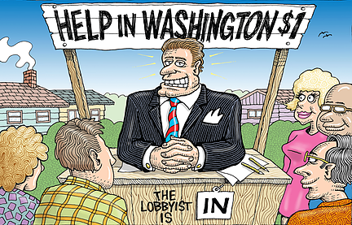
Lobbying
Lobbyist an activist who seeks to persuade members of the government (like members of Congress) to enact legislation that would benefit their group.
Clients spent $3.42 billion on lobbying in 2018

Slide 21
Discussion Time
For each of the following slides, discuss the following with your group.
Do you agree or disagree with the idea?
Why or why not?
Why would this issue be a concern?

Slide 22
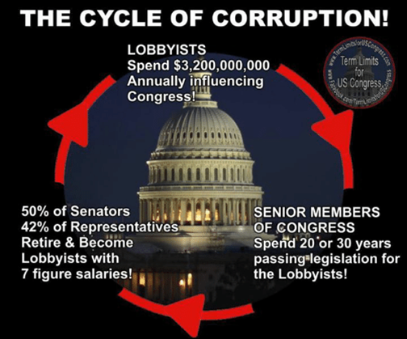
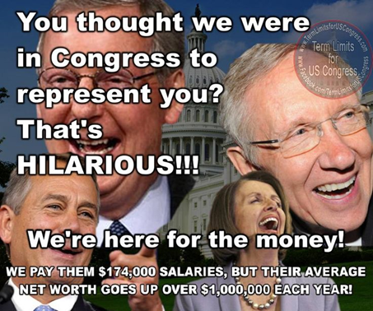

Slide 23
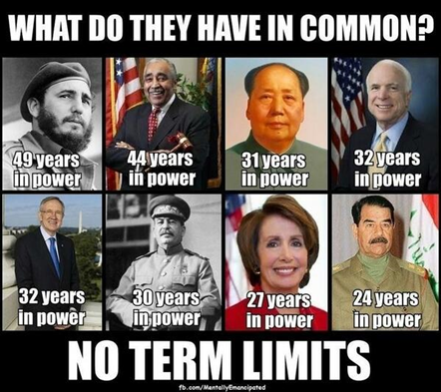
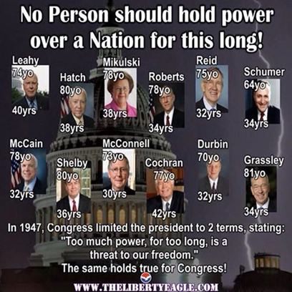
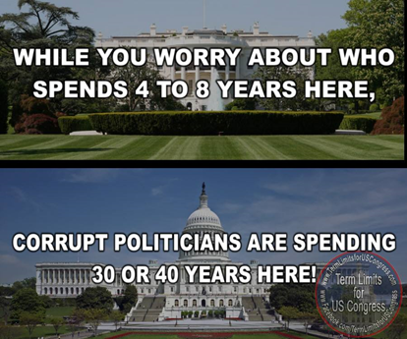

Slide 25
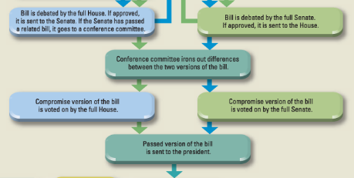

Slide 26
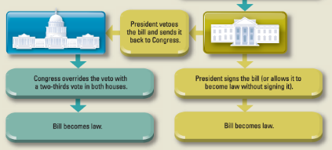

Slide 27
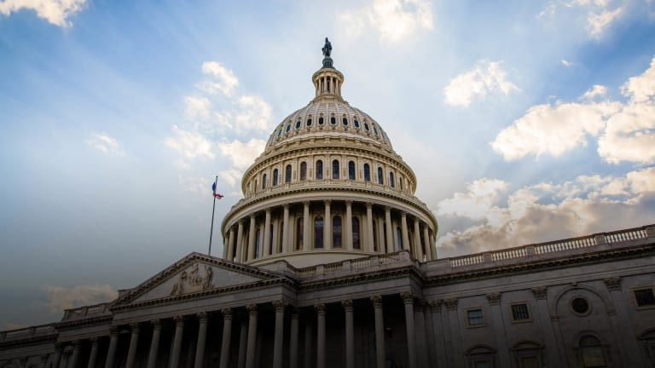
Lawcraft

Slide 28
Law Craft Debrief
Did you have fun?
How many bills did you get passed?
Was the process easy or difficult? Why?
What do you think of the bill process?
What is the trick?
Should it be changed? Why or why not?
What do you think the biggest challenge for congress is when passing a bill?

