Slide 1
March 27, 2019
Out for Stamp:
Life of Buddha Questions
Take out:
Agenda:
Buddhism
Learning Targets (I can…):
Explain the origins of Buddhism and its basic beliefs
Important Dates:
3/29: Eastern Thought Quiz

Slide 2
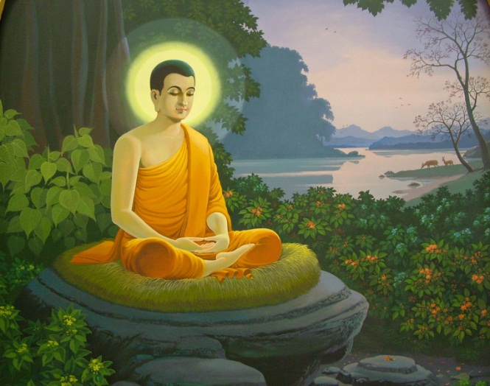
What do you know about Buddhism?

Slide 3
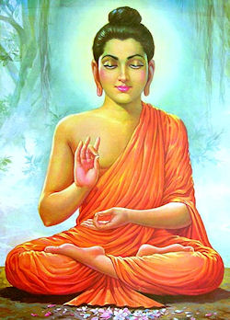
Siddhartha Gautama
Born 583 BCE to a royal family
Predicted to be either a great military leader or a great teacher
His father (the King) wanted to him to be a military leader, kept him in the palace until the age of 29

Slide 4
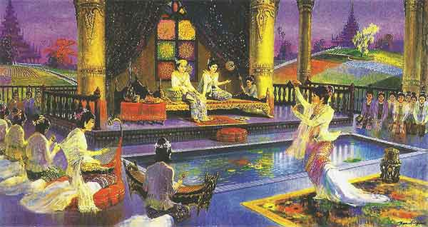

Slide 5
Siddhartha Gautama
Leaves the temple on a chariot ride
Sees 3 men: Old Man
Sick Man
Dead Man
Also sees an ascetic
Ascetic:
Someone who renounces the world and seeks release from fear of death and suffering

Slide 6
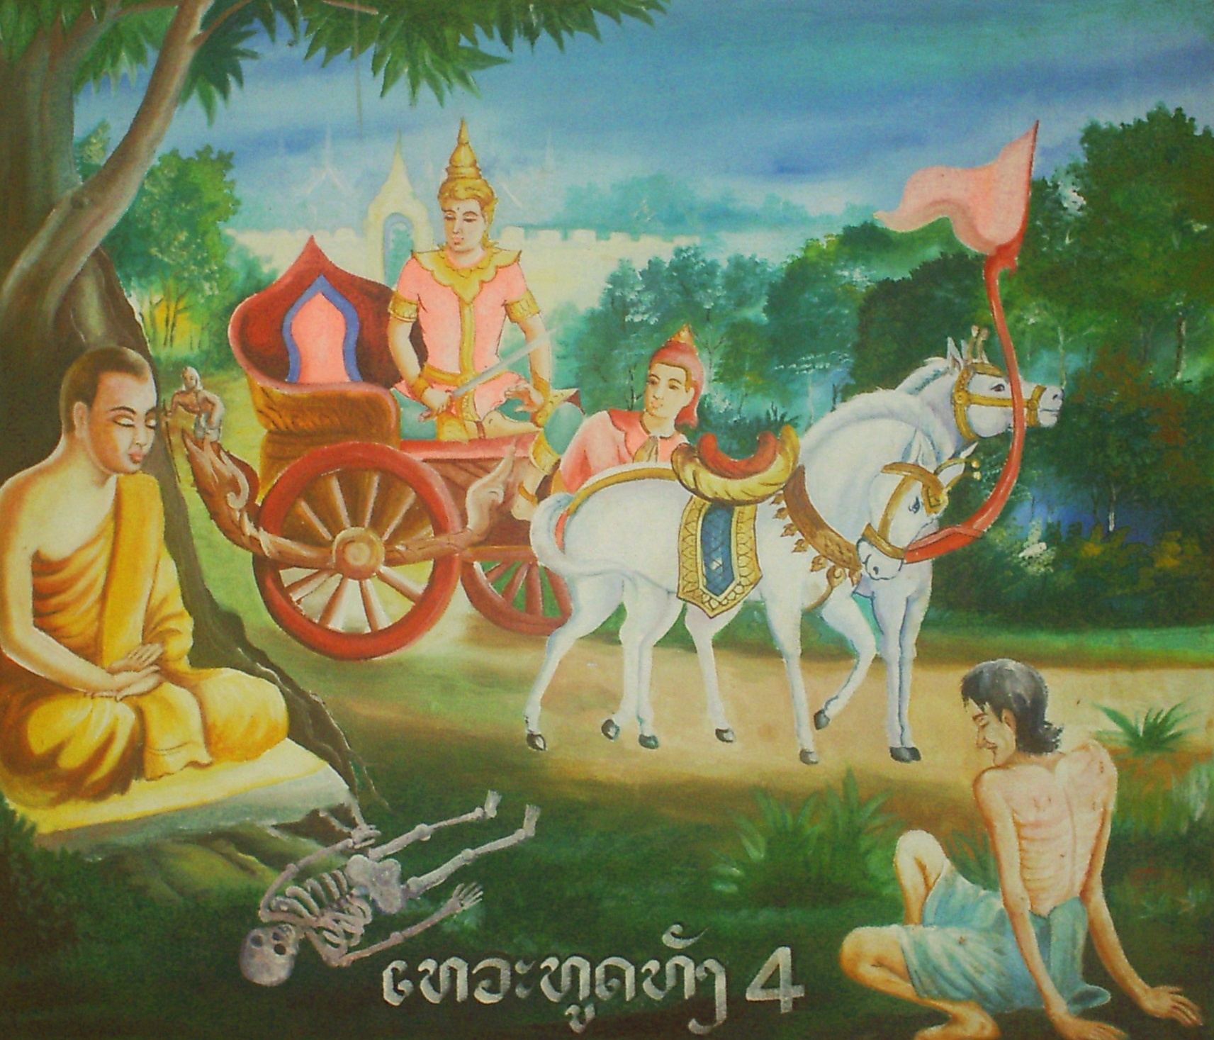

Slide 7
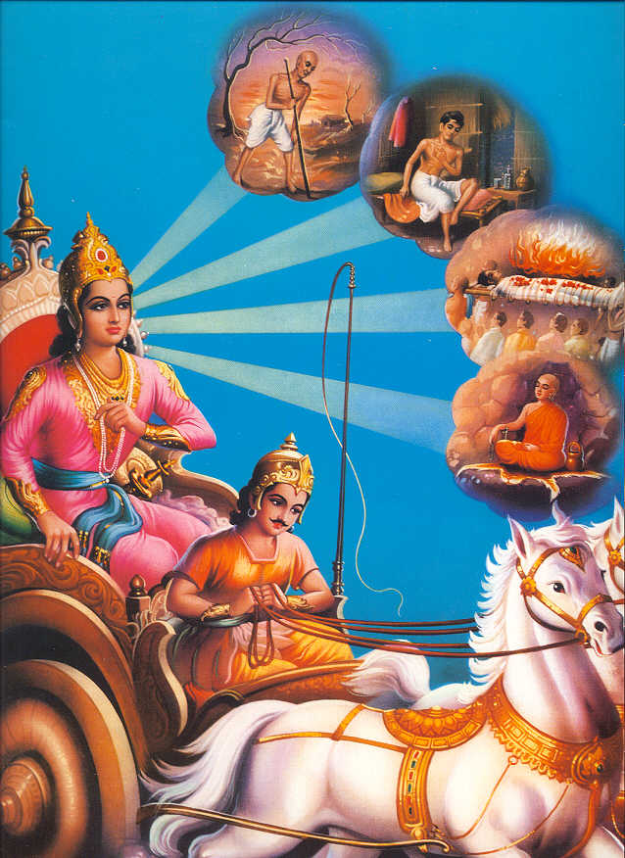

Slide 8
Siddhartha Gautama
Returns to the temple, but is disenchanted by his material wealth
On his journey, the realities of life impacted him
Seeks out renowned teachers, rejects pleasures of old life

Slide 9
The Middle Way
Siddhartha becomes unsatisfied with fasting
Determines that the Middle Way, a balance between pleasure and pain, was the way to achieve enlightenment
Siddhartha settles under the Bodhi Tree and begins to meditate

Slide 10
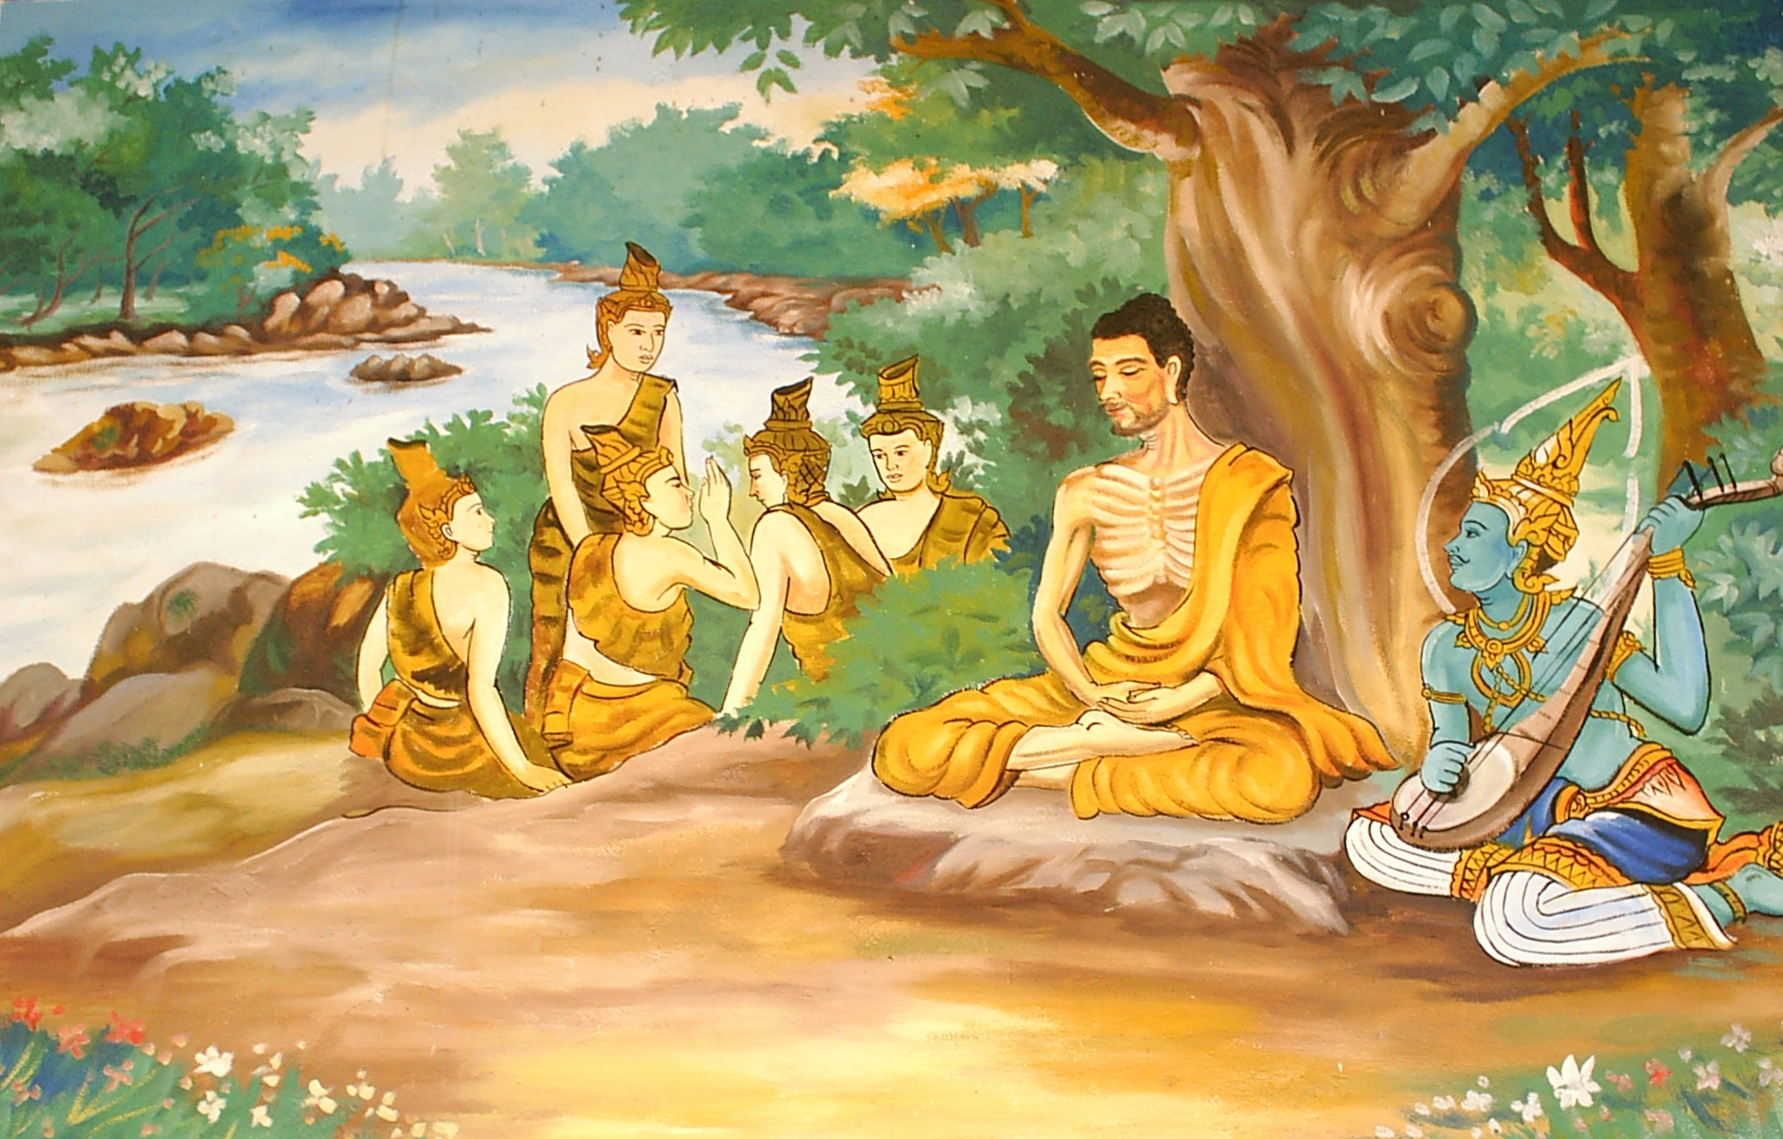

Slide 11
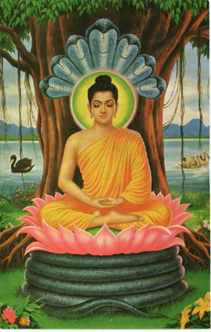
The Buddha
Buddha develops the 4 Noble Truths:
The Truth of Suffering
Life is suffering
The Truth of the Cause of Suffering
Suffering is based on the search for happiness outside ourselves
The Truth of the End of Suffering
Attempt to reach Nirvana through ending the chase for satisfaction
The Truth of the Path That Frees Us From Suffering
The 8-Fold Path

Slide 12
The Buddha
The Path is divided into three main sections: wisdom, ethical conduct, and mental discipline.
Wisdom: Right View and Right Intention are the wisdom path. Right View is not about believing in doctrine, but in perceiving the true nature of ourselves and the world around us. Right Intention refers to the energy and commitment one needs to be fully engaged in Buddhist practice.
Ethical Conduct: Right Speech, Right Action and Right Livelihood are the ethical conduct path. This calls us to take care in our speech, our actions, and our daily lives to do no harm to others and to cultivate wholesomeness in ourselves.
Mental Discipline: Through Right Effort, Right Mindfulness, and Right Concentration we develop the mental discipline to cut through delusion. Many schools of Buddhism encourage seekers to meditate to achieve clarity and focus of mind.

Slide 13
The 8-Fold Path
Right View
Right Intention
Right Speech
Right Action
Right Livelihood
Right Effort
Right Mindfulness
Right Concentration

Slide 14
Buddhism
Cycle of Rebirth
Atman- “Self”
Karma
Dharma
Meditation
Nirvana- Withdrawal from cycle of rebirth
Four Noble Truths
Eightfold Path: how to achieve nirvana
Buddha: One who is fully enlightened
Mantra: Phrases chanted

Slide 15
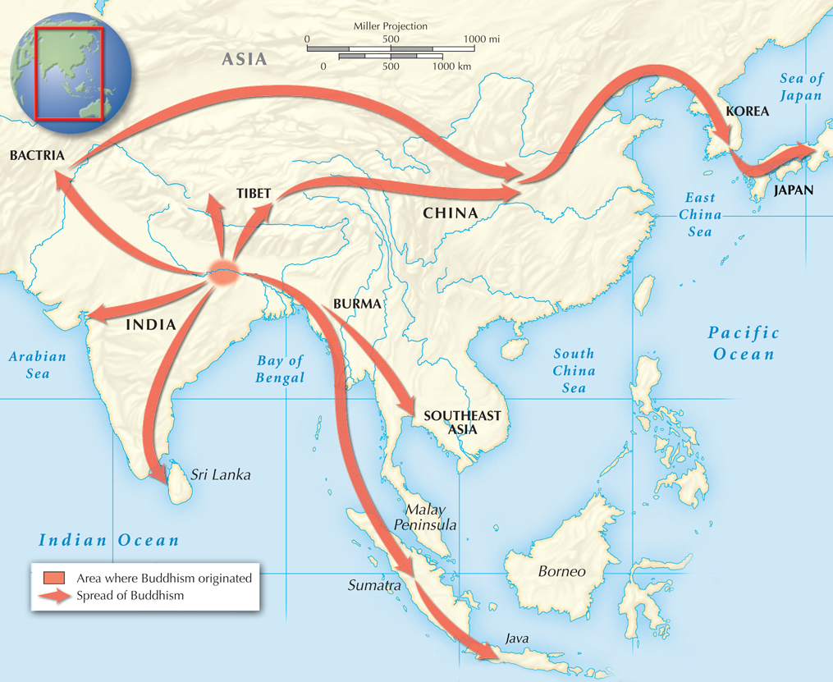
Buddhism rejected the Hindu caste system.
Rather than focusing on priests, rituals, and deities, Buddhism encouraged each person to seek self-enlightenment.
The religion spread as the Buddha’s teachings were recorded.

Slide 16
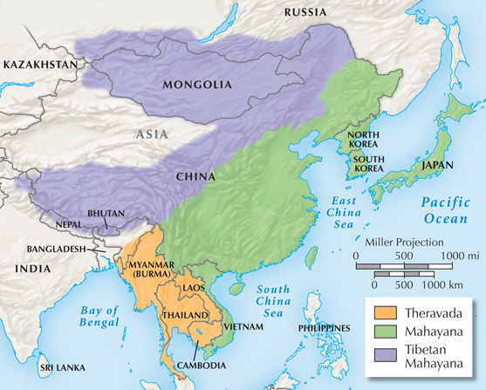
Buddhism split into two major sects: Theravada Buddhism and Mahayana Buddhism.
Buddhism eventually declined in India, but took root in other parts of Asia.

Slide 19
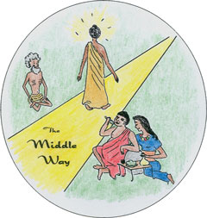

Slide 20
Yoga

Slide 21
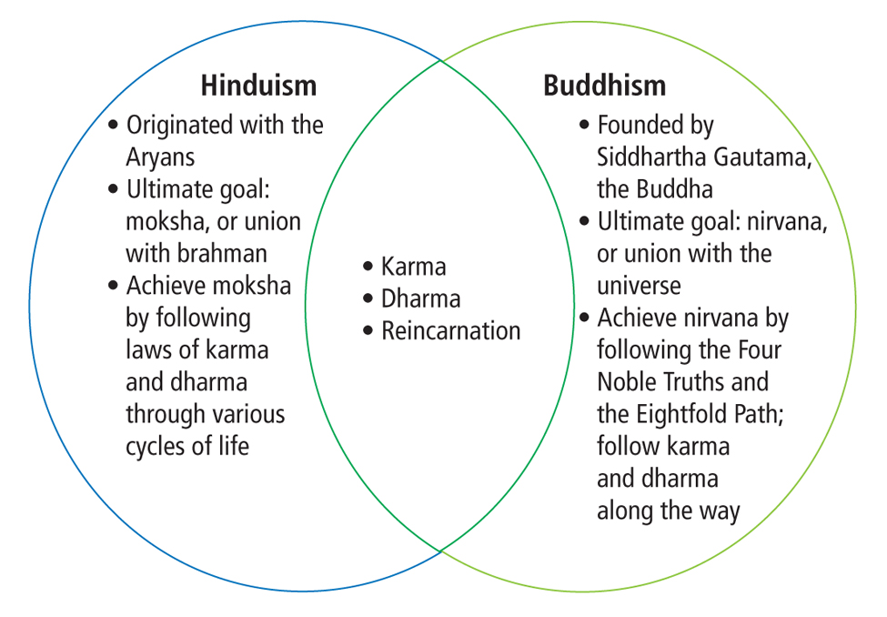
Religions Founded in India

