Slide 1
Hindu Deities
Some common misconceptions people have about Hinduism is that Hindus worship idols. This is understandable because the majority of the world is Islam and Christianity and these two religions forbid idolatry. However, in Hinduism, worshiping an idol is thought off as direct worship to the gods instead of a representation of the gods. That holds a big difference in our culture and is why it is a misconception.
-Skyline Student

Slide 2
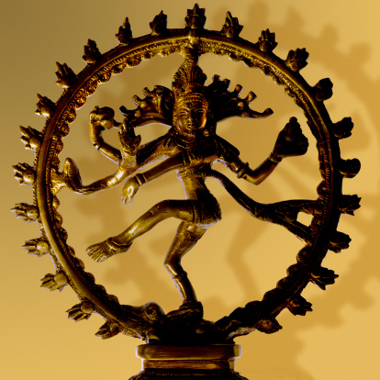
Hindus worship a variety of deities, gods and goddesses who are concrete forms of Brahman.
The three key Hindu deities are:
Brahma, the Creator
Vishnu, the Preserver
Shiva, the Destroyer
Shiva
Notes:
http://college.holycross.edu/projects/himalayan_cultures/2006_plans/esnyder/h_practice_lesson_one.html

Slide 3
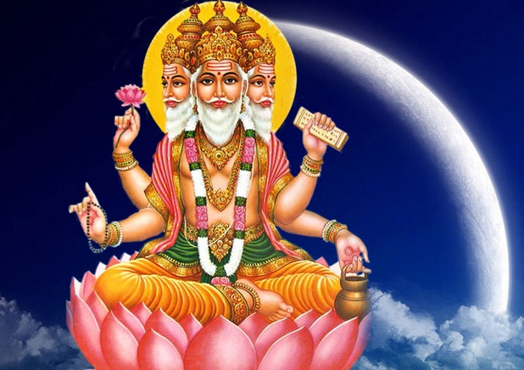
Brahma:
The creator of the universe

Slide 4
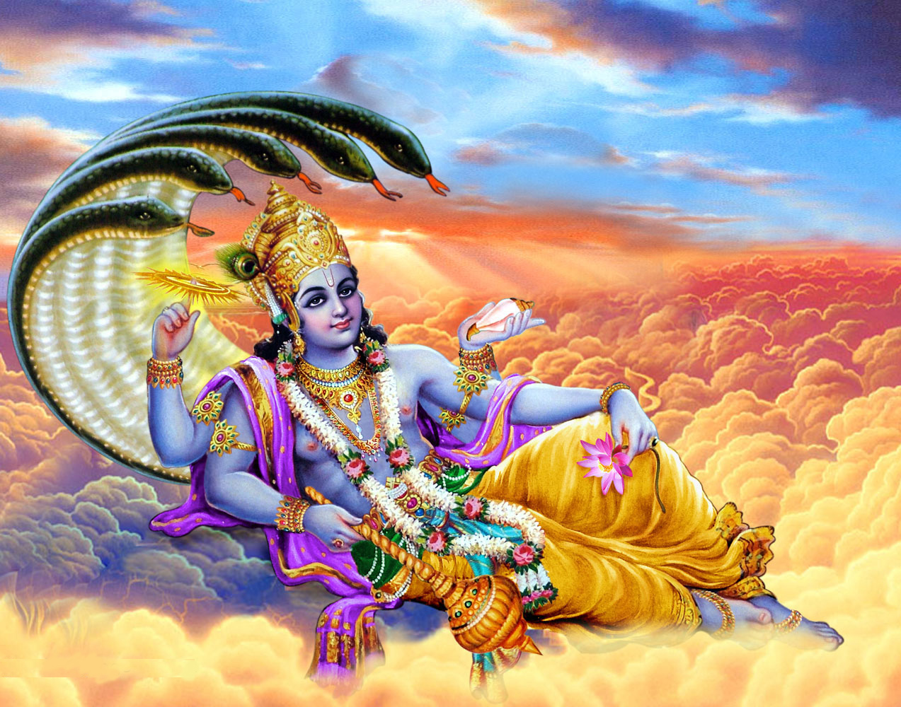
Vishnu
The Preserver of the Universe

Slide 5
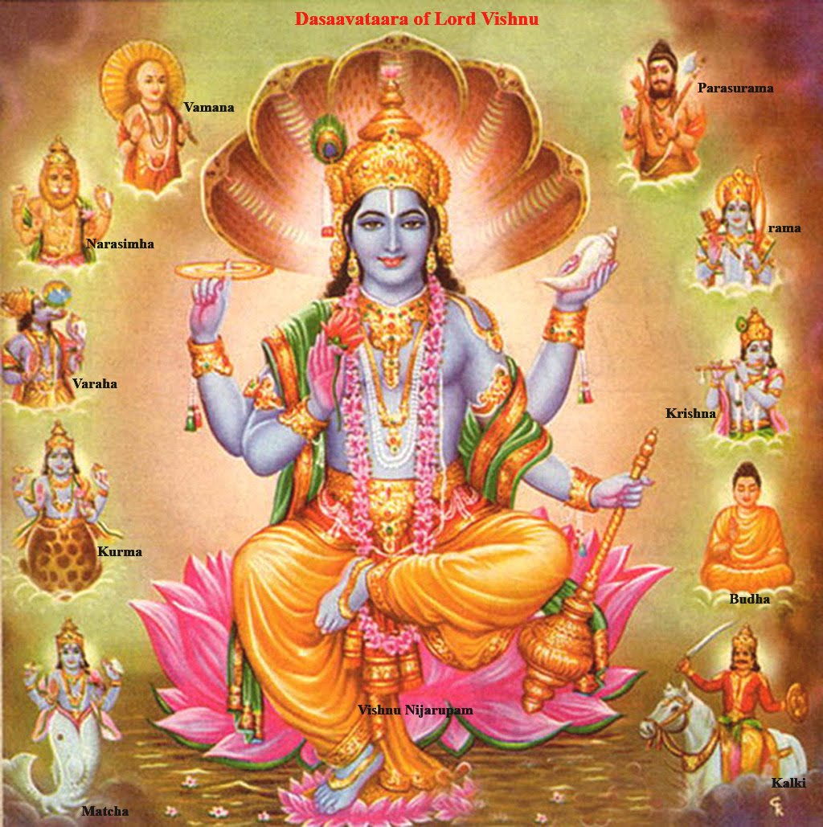
Avatars
The Ten Avatars (incarnations)
of Vishnu

Slide 6
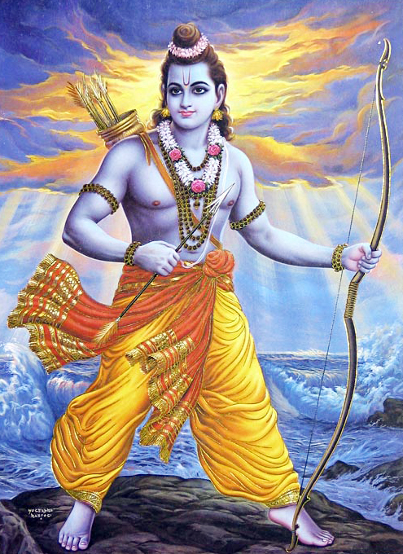
Rama
Embodiment of chivalry and virtue
7th incarnation of Vishnu

Slide 7
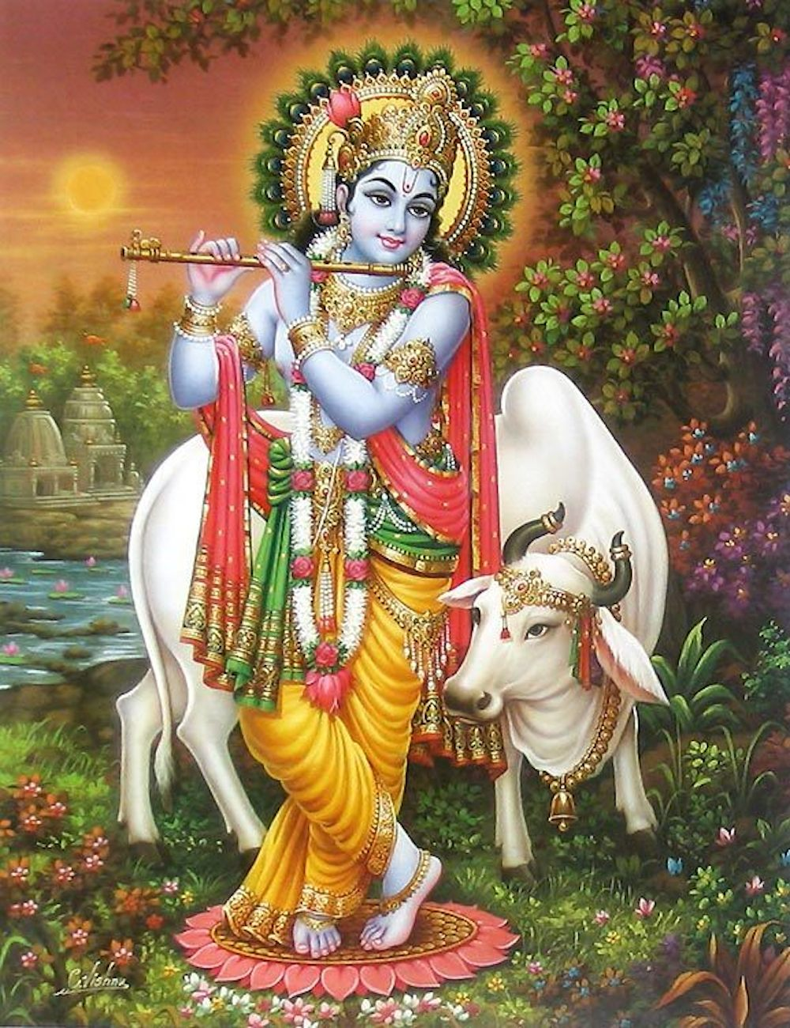
Krishna
Embodiment of Love, joy, playfulness
Raised by cowherds and renowned as mischievous and a lover
8th incarnation of Vishnu

Slide 8
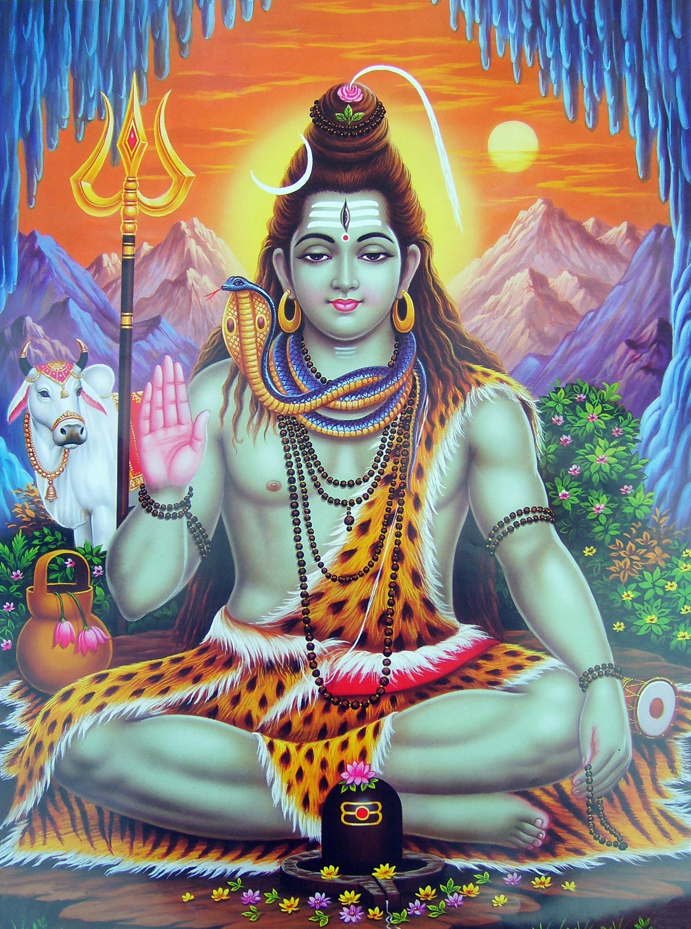
Shiva
The destroyer,
The transformer,
The creator
Will eventually destroy the world and restart the universe’s cycle

Slide 9
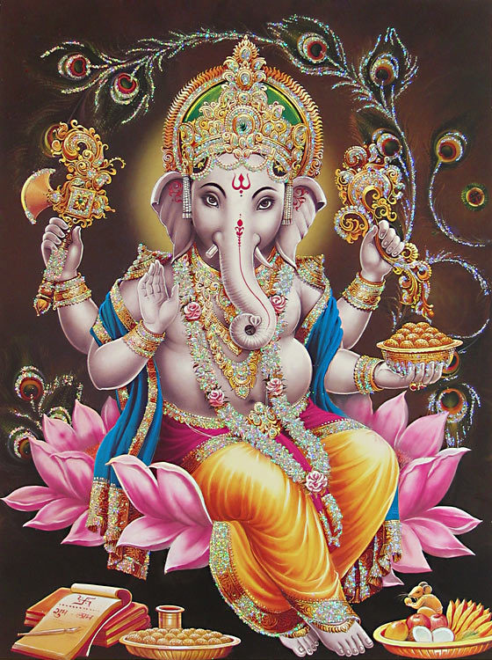
Ganesh
The remover of obstacles.
The god of intellect and wisdom.

Slide 10
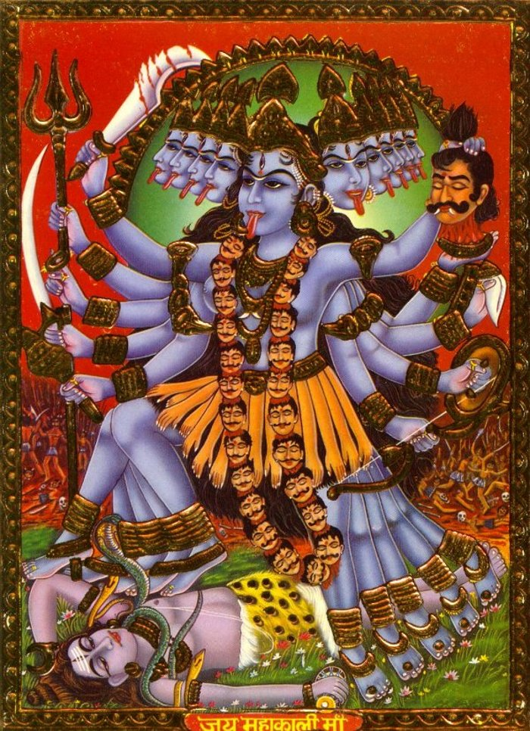
Kali
Goddess of time, doomsday, death

Slide 11
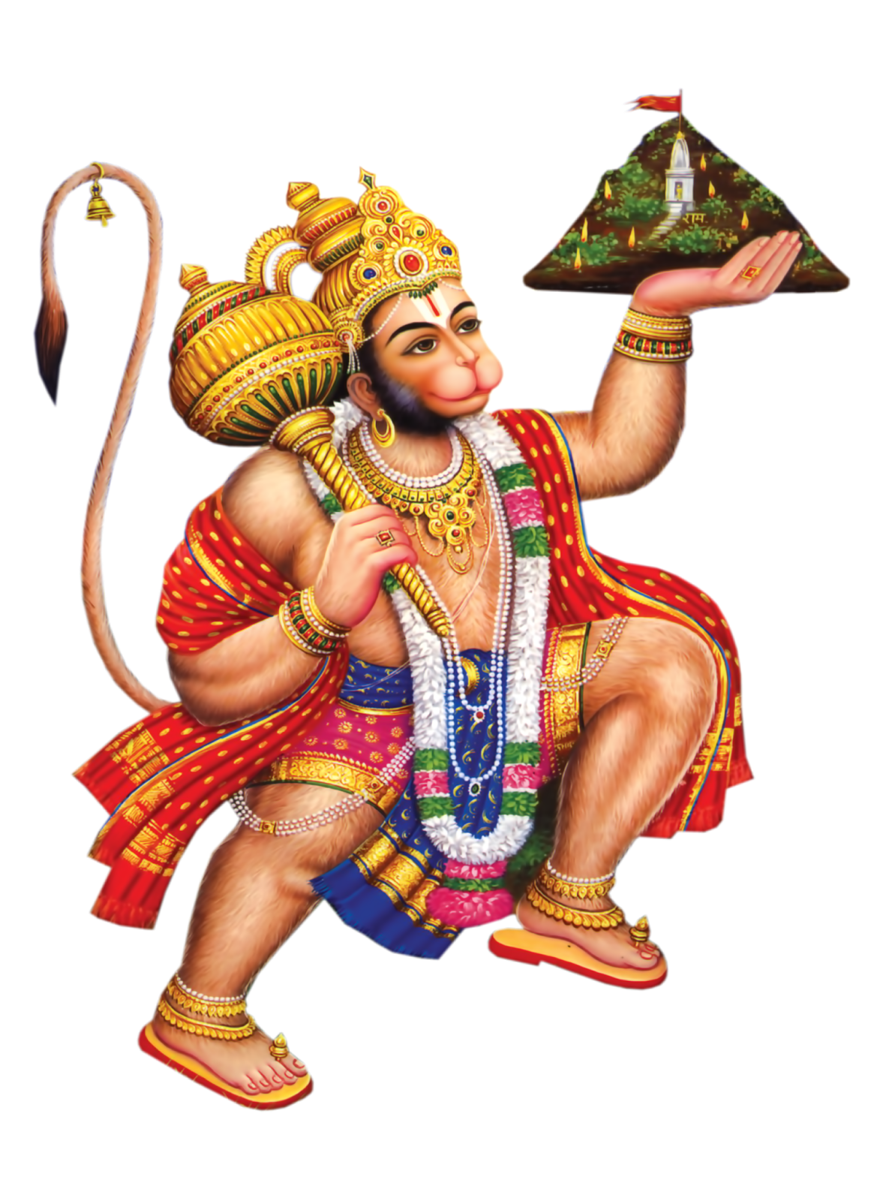
Hanuman
Leader of monkey armies in Ramayana
Helped Rama recover his wife Sita from the demon king Ravana
Brought mountain of herbs from Himalayas to heal wounded.

Slide 12
Let’s Discuss
Why do you think there are so many Hindu gods/incarnation of the Brahma?
What role do the deities play in their lives?
Are the deities more beloved or feared?

Slide 13
Question for thought
Which of the Hindu incarnations would you seek out and why?
Would you search for an incarnation that represented/oversaw something else that wasn’t shown today?

