Slide 1
The Founding Principles of the Constitution

Slide 2
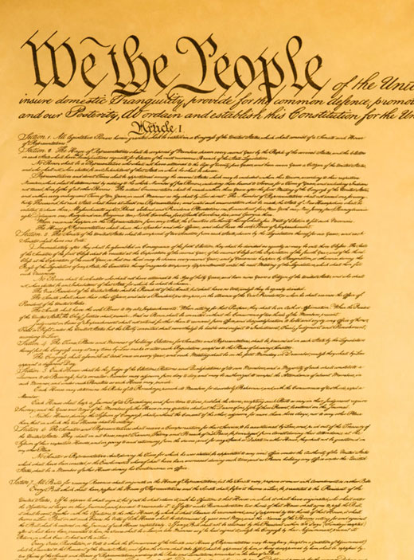
With our powers combined!
Limited Government
Seperation of Powers
Popular Sovereignty
Rule of Law
Federalism
Representative Government
Checks & Balances
Consent of the Governed

Slide 3
Popular Sovereignty
The principle that a government’s power is derived from the people.
Sovereignty - the full right and power of a governing body over itself, without any interference from outside sources or bodies.

Slide 4
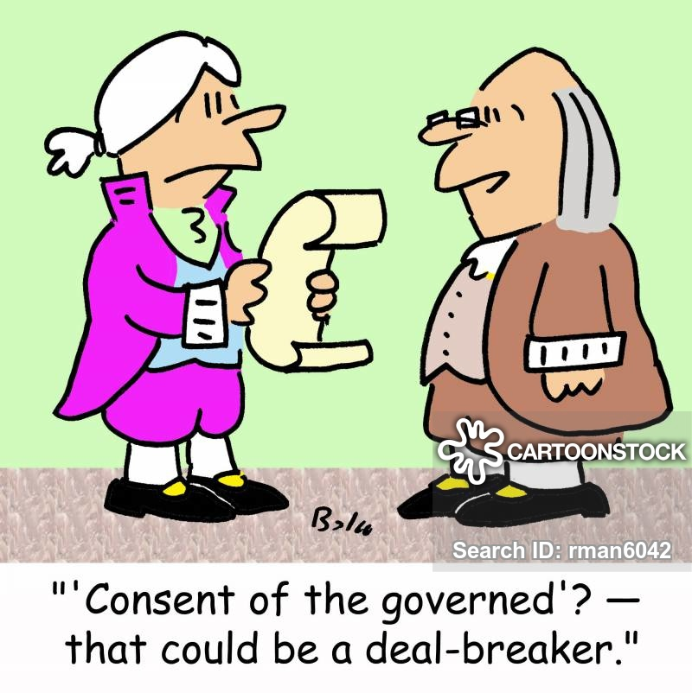
Consent of the Governed
How do people give their consent to the government?
The concept that the government must have the approval(consent) from the people.
Goes hand in hand with popular sovereignty.

Slide 5
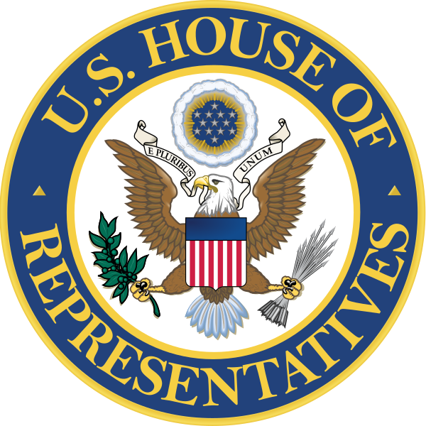
Representative Government
A government where citizens elect representatives to government.
Those representatives are able to make the laws and policies that run the country.

Slide 6
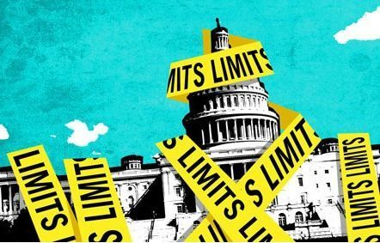
Limited Government
A government only has the power that has been given to it.
The government does not have unlimited power.

Slide 7
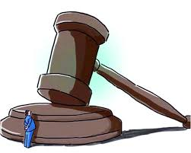
Rule of Law
The principle that society is governed by laws, not people, and that even the government must follow the law.
AKA: NO ONE IS ABOVE THE LAW!

Slide 8
Separation of Powers
The power of the government should be divided to create a fail safe against tyranny.
There should be independent branches of government with their own powers.

Slide 9
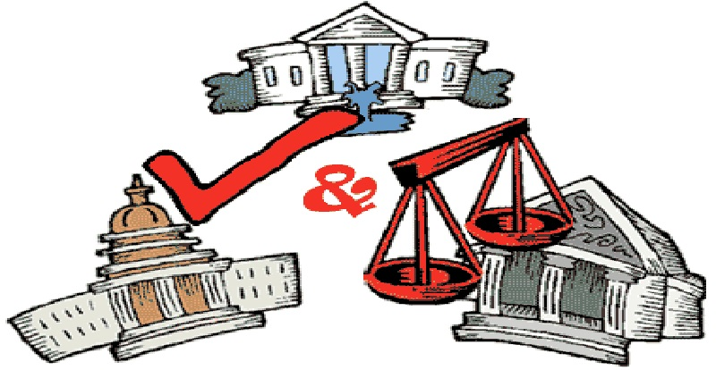
Checks and Balances
Gives each branch of the government the ability to restrain certain actions the other branches take.
To avoid one branch from taking control of the others.

Slide 10
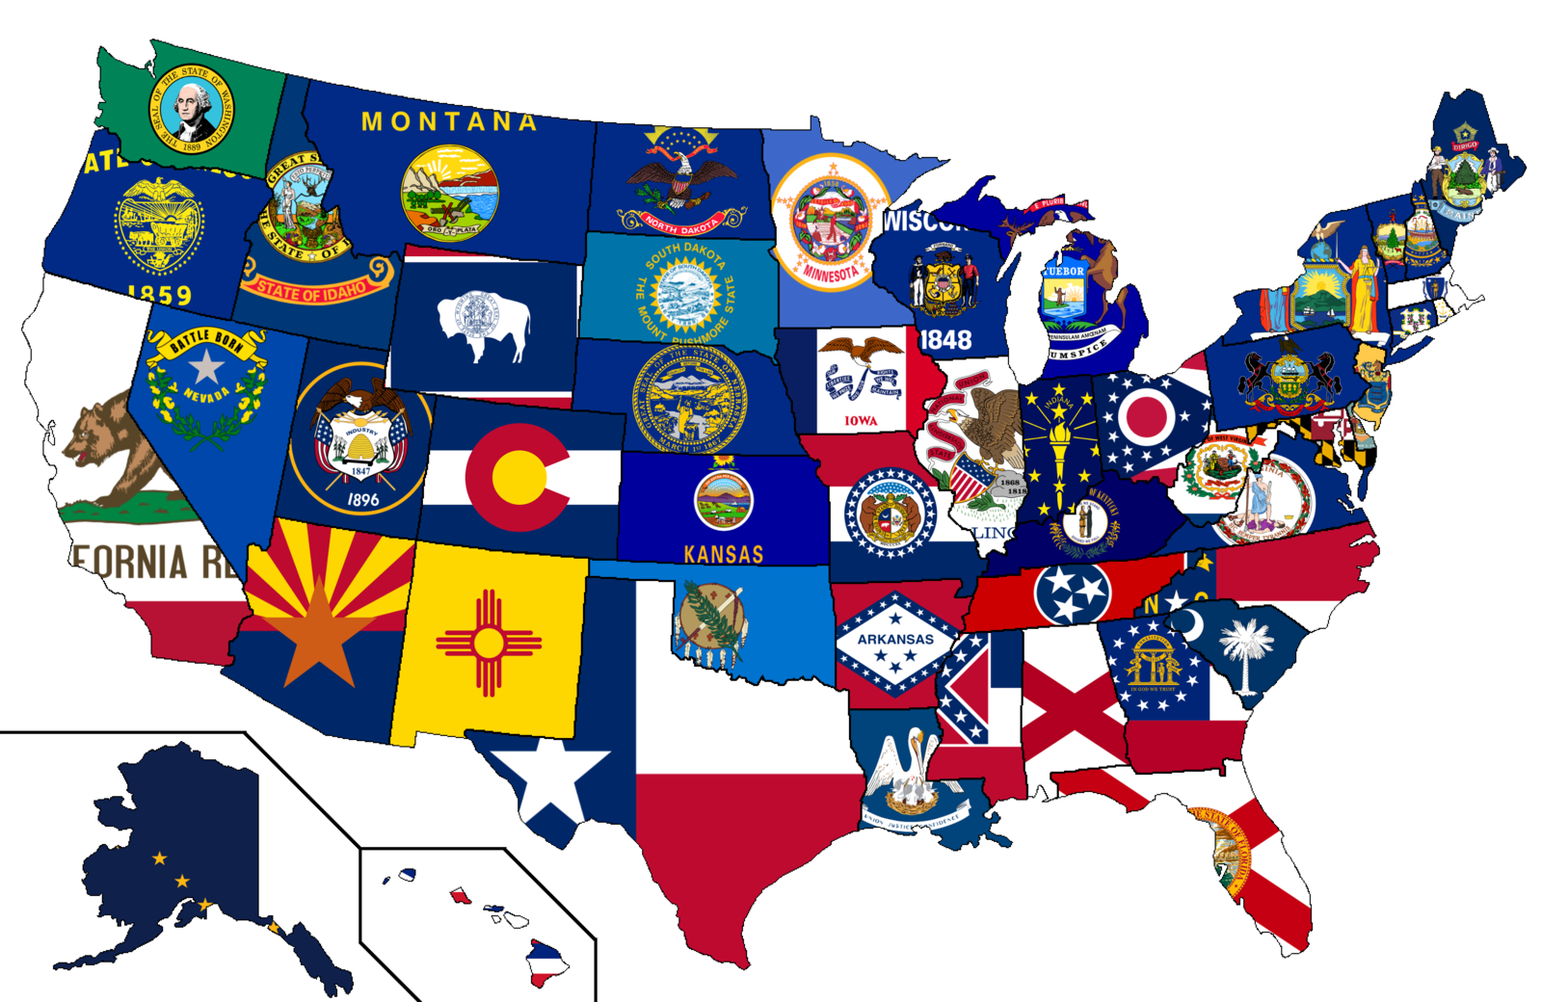
Federalism
A system in which power is divided between a central government and smaller regional governments. (The States)
Why should the states have different set of laws than the national government?

